Slide 1
How to characterize Software Robustness
A formal approach
Changjian (CJ) Zhang
Eunsuk Kang
David Garlan
Carnegie Mellon University

Slide 2
Agenda
What is Robustness?
Motivation Example
Generating Weakest Assumption
Representation of Robustness
Discussion

Slide 3
What is Robustness?
In general, robustness is the capability of a system to deal with uncertainty.
Uncertainty refers to the differences or errors between models and reality, and whatever mechanism is used to express these errors will be called a representation of uncertainty. [Essential of Robust Control]
Notes:
This definition is not limited to control theory.
Can be applied to many domains, the key is how to define the models and differences

Slide 4
Expected vs Reality
Domain | Expected | Diffs in Reality
Statistics/Machine Learning | Data samples should be in certain distributions | Outliers/Noise in data samples
Distributed Systems | Network is perfect and servers won’t crash | Message lost, duplication; Server crash
Software Security | Attackers only have certain capability (tactics) | Unknown tactics; How they exploit
Human-Computer Interaction | Human operators will follow instructions | Human mistakes
… | … | …
Notes:
Uncertainty comes from the differences between expected versus reality
I can do this all day!

Slide 5
What is Robustness in Software?
IEEE definition:
The degree to which a system or component can function correctly in the presence of invalid inputs or stressful environmental conditions.
Existing Work:
Fuzz Testing – uses massive amounts of random input data to fail a system.
Chaos Engineering – puts a system in an extremely chaos environment to fail the system.
… (Mostly focus on verification)
Notes:
IEEE definition OK, but what is correct function, invalid inputs, and stressful env. Need more context
Fuzz testing focuses more on the erroneous input data, and chaos engineering focuses more on the stressful environment
They are great methods, but the problem for testing is that you cannot tell what a system can do and what a system cannot do exhaustively.
For the latter one, that what a system cannot do, it’s often impossible to enumerate all the errors.
But for the first one, we may be able to answer what a system can do, that’s our focus.

Slide 6
What is Robustness in Software?
IEEE definition:
The degree to which a system or component can function correctly in the presence of invalid inputs or stressful environmental conditions.
Existing Work:
Fuzz Testing – uses massive amounts of random input data to fail a system.
Chaos Engineering – puts a system in an extremely chaos environment to fail the system.
… (Mostly focus on verification)
Error Rate as an approximation of robustness.
No direct measurements
Notes:
IEEE definition OK, but what is correct function, invalid inputs, and stressful env. Need more context
Fuzz testing focuses more on the erroneous input data, and chaos engineering focuses more on the stressful environment
They are great methods, but the problem for testing is that you cannot tell what a system can do and what a system cannot do exhaustively.
For the latter one, that what a system cannot do, it’s often impossible to enumerate all the errors.
But for the first one, we may be able to answer what a system can do, that’s our focus.

Slide 7
Motivation
For a given system, can we tell what a system can do/cannot do without using trial-and-error?
To achieve correct-by-design, can we tell how robust a system is in advance?

Slide 8
Motivation
For a distributed protocol, what are the fault models it can handle?
For a security protocol, what are all the possible exploits it can protect from?
For a human-computer interface, what are all the human errors it can deal with?

Slide 9
Research Focus
How to characterize the ability of a system to ensure correct function against erroneous behaviors in the environment?
What’s the definition of correct system function?
How to represent system/environment behaviors?
What’s the representation of system ability to handle erroneous behaviors (i.e., the representation of robustness)?

Slide 10
Motivation Example

Slide 11
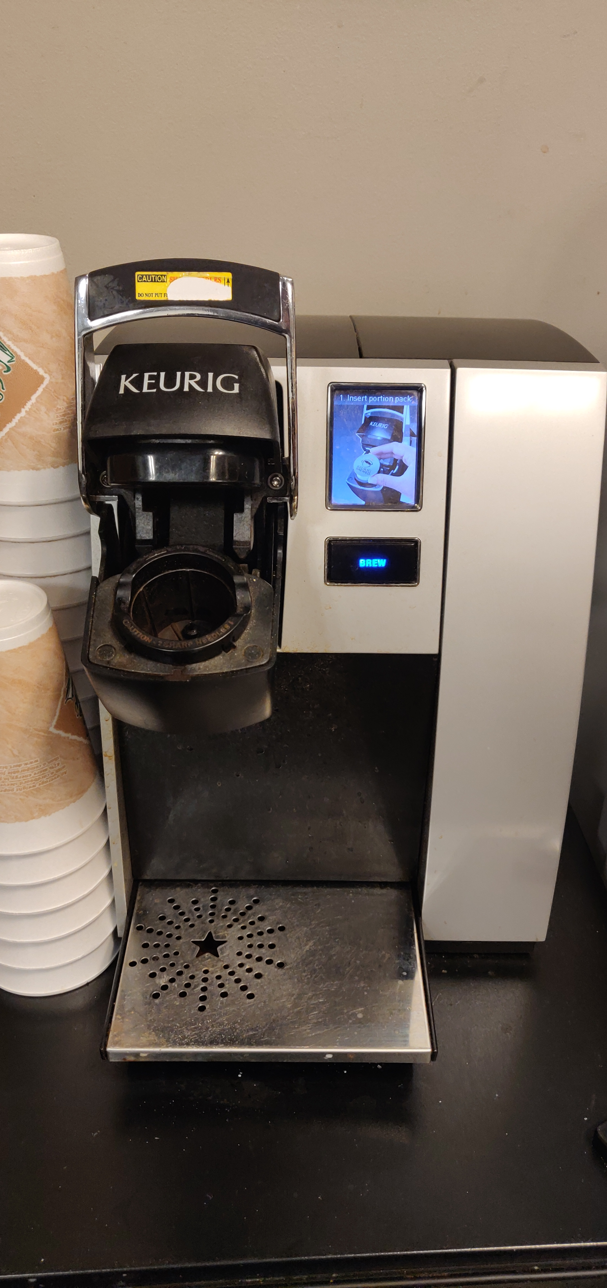
Motivation Example
System: the coffee machine.
Environment: Human behavior.
A system is correct when it satisfies certain properties.
Safety Property: the system should not do something.
Liveness Property: the system should do something.

Slide 12
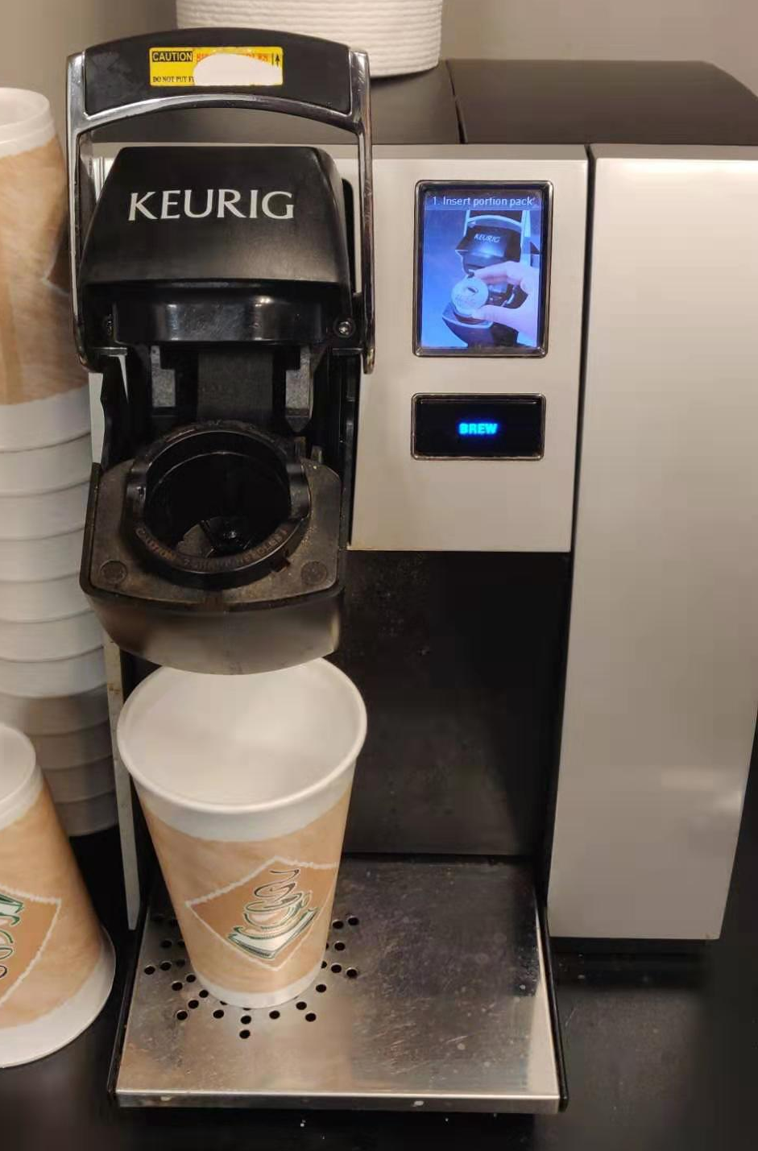
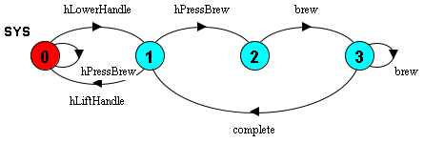
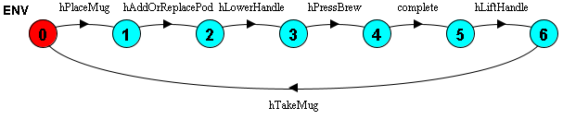
Behavior Model
Use Labelled transition system (LTS)

Slide 13
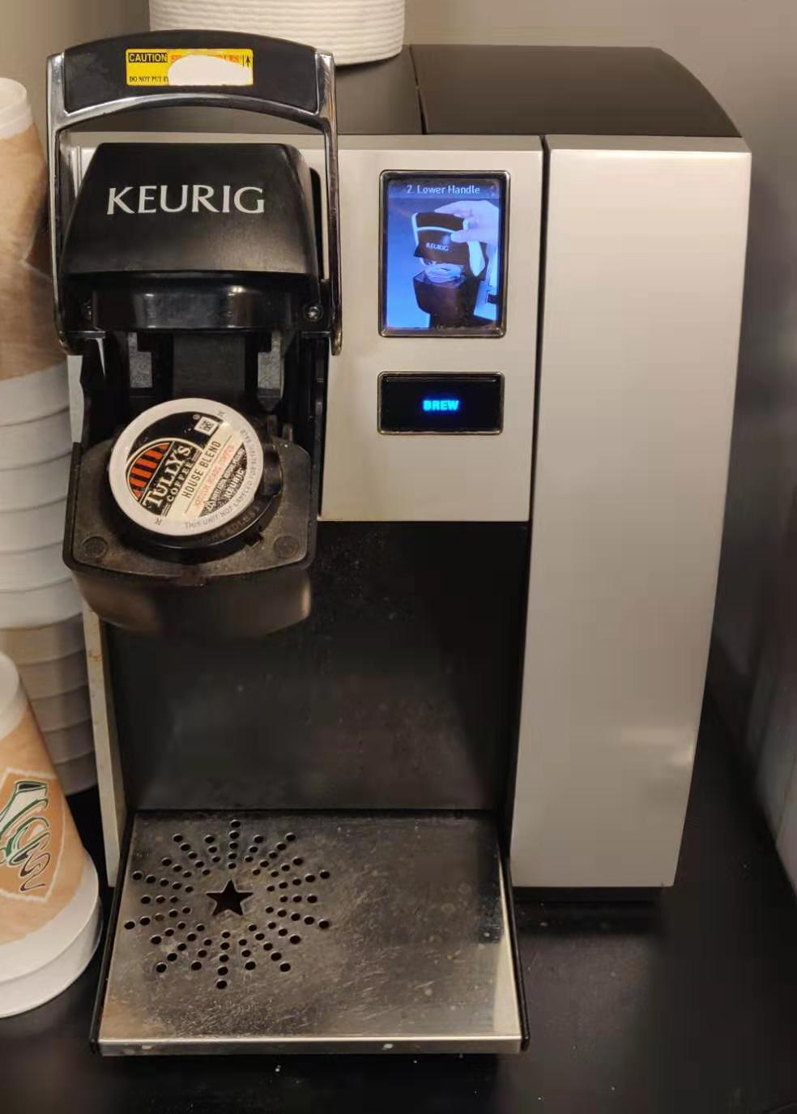
Behavior Model
Use Labelled transition system (LTS)
0 indicates the initial state.
State in red indicates the current state.

Slide 14
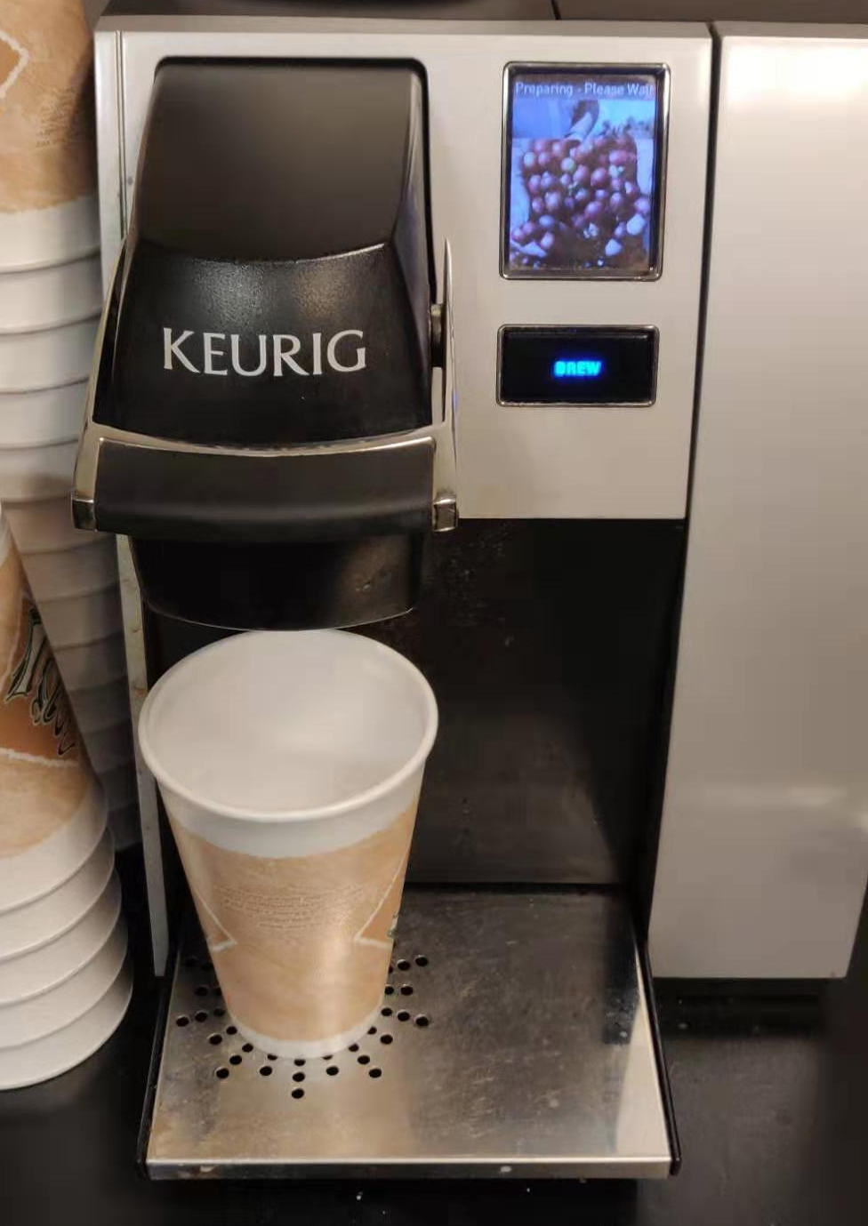
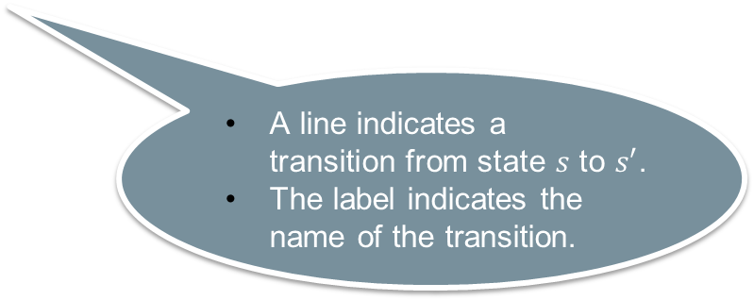
Behavior Model
Use Labelled transition system (LTS)
A line indicates a transition from state $s$ to $s′$.
The label indicates the name of the transition.

Slide 15
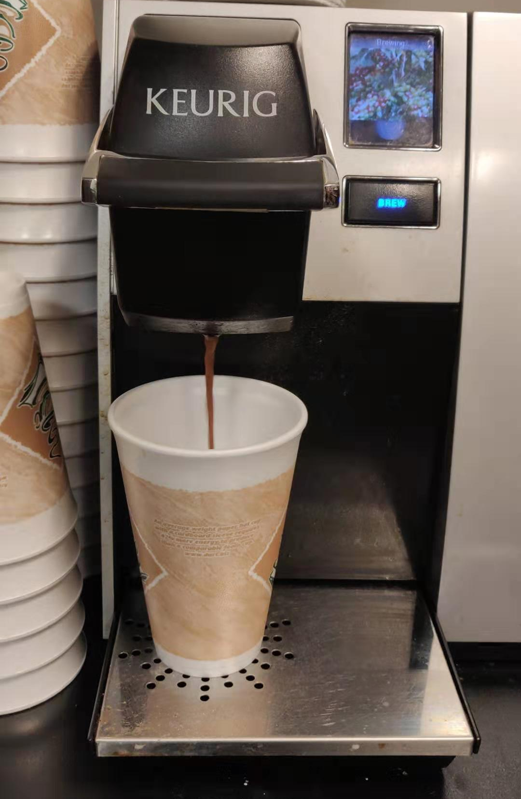
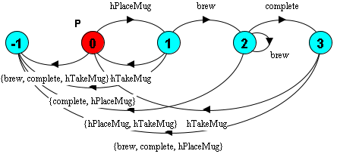
Safety Property
A safety property is an LTS which describes the acceptable behavior of the system.
E.g., brewing only when the mug is placed.

Slide 16
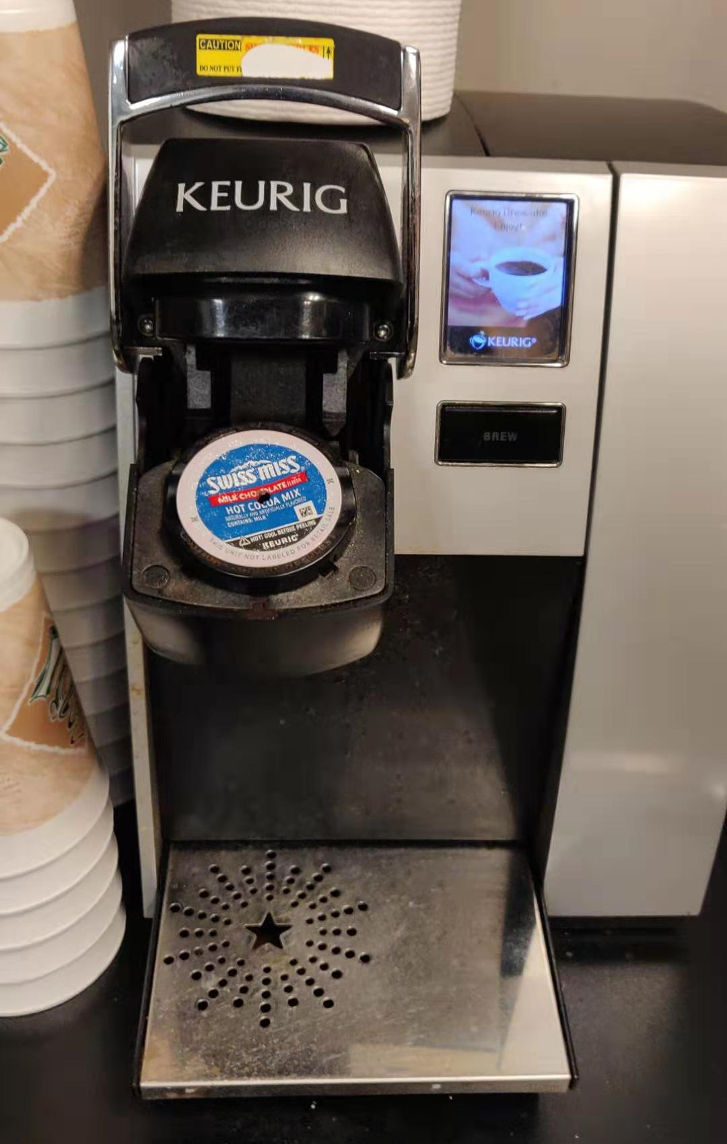
Safety Property
A safety property is an LTS which describes the acceptable behavior of the system.
E.g., brewing only when the mug is placed.
-1 indicates the error state.
The system should not reach the error state.

Slide 17
Safety Property Satisfied!
The property is satisfied by model checking.

Slide 18
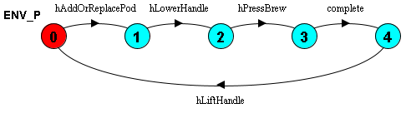
Example of Human Error
Forgot to place the mug!!!

Slide 19
Example of Human Error

Slide 20
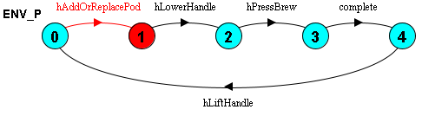
Example of Human Error

Slide 21
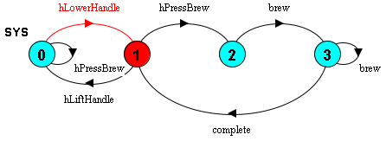
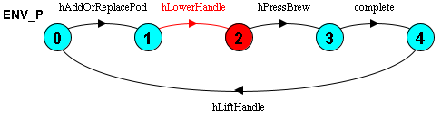
Example of Human Error

Slide 22
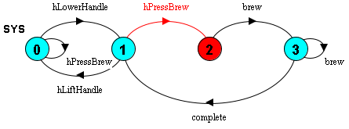
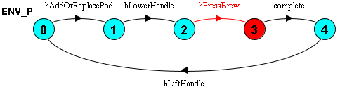
Example of Human Error

Slide 23
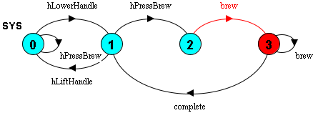
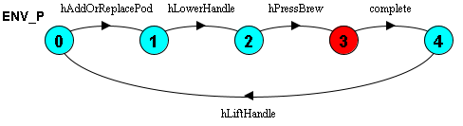
Example of Human Error

Slide 24
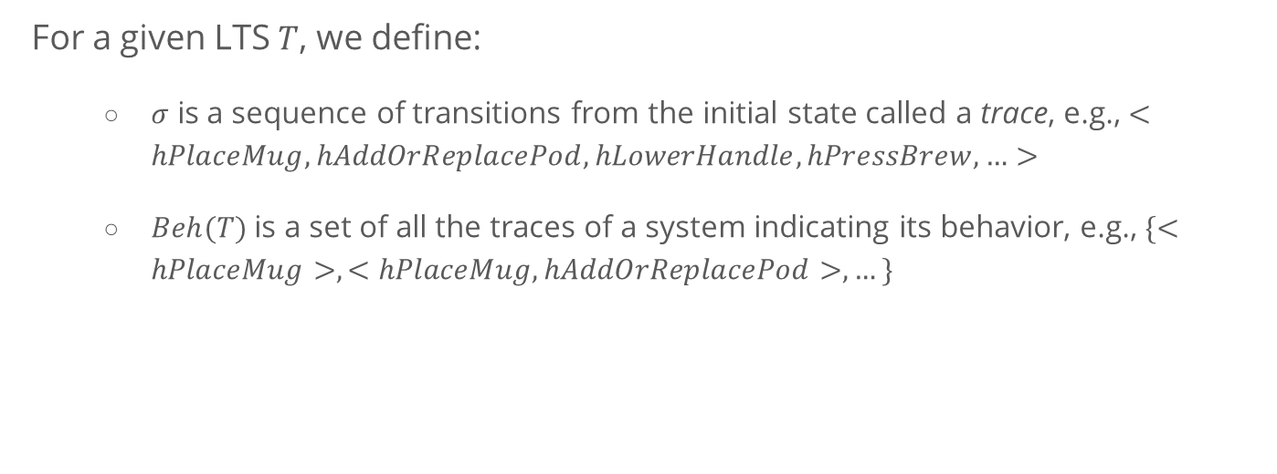
A Formal View of Testing Robustness
For a given LTS $T$, we define:
$σ$ is a sequence of transitions from the initial state called a trace, e.g., $<hPlaceMug, hAddOrReplacePod, hLowerHandle, hPressBrew,…>$
$Beh(T)$is a set of all the traces of a system indicating its behavior, e.g., $\{<hPlaceMug>, <hPlaceMug, hAddOrReplacePod>, …\}$

Slide 25


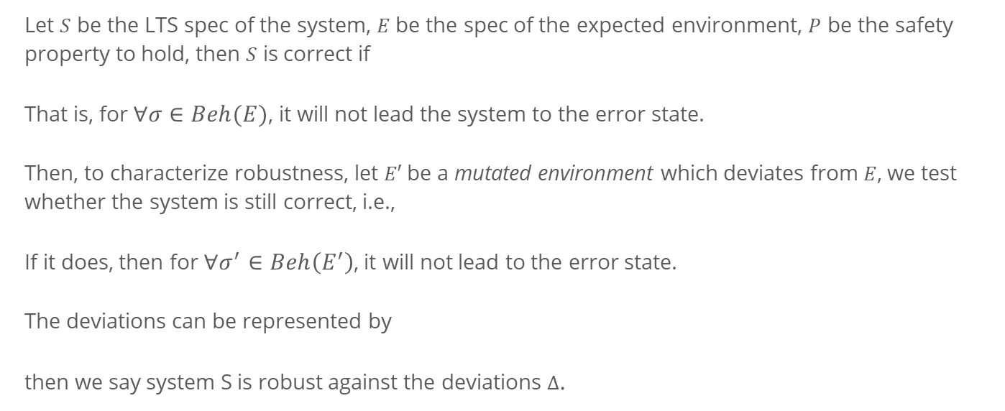
A Formal View of Testing Robustness
Let $S$ be the LTS spec of the system, $E$ be the spec of the expected environment, $P$ be the safety property to hold, then $S$ is correct if
That is, for $∀σ∈Beh(E)$, it will not lead the system to the error state.
Then, to characterize robustness, let $E′$be a mutated environment which deviates from $E$, we test whether the system is still correct, i.e.,
If it does, then for $∀σ^{′}∈Beh\left(E^{′}\right)$, it will not lead to the error state.
The deviations can be represented by
then we say system S is robust against the deviations $Δ$.

Slide 26
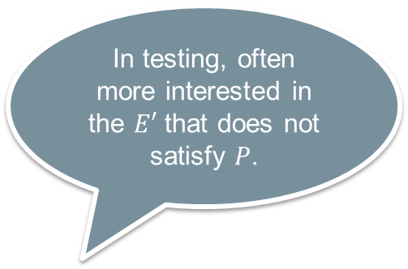
A Formal View of Testing Robustness
Let $S$ be the LTS spec of the system, $E$ be the spec of the expected environment, $P$ be the safety property to hold, then $S$ is correct if
That is, for $∀σ∈Beh(E)$, it will not lead the system to the error state.
Then, to characterize robustness, let $E′$be a mutated environment which deviates from $E$, we test whether the system is still correct, i.e.,
If it does, then for $∀σ^{′}∈Beh\left(E^{′}\right)$, it will not lead to the error state.
The deviations can be represented by
then we say system S is robust against the deviations $Δ$.
In testing, often more interested in the $E′$ that does not satisfy $P$.
Hard to explore all the possible deviations!
Notes:
In the coffee machine example, we developed an erroneous environment model and verified that it does not satisfy the property.
However, this is just one case, it is often impossible to enumerate all the human behaviors.
Thus, we cannot tell what kind of errors the system can handle and what it cannot.

Slide 27

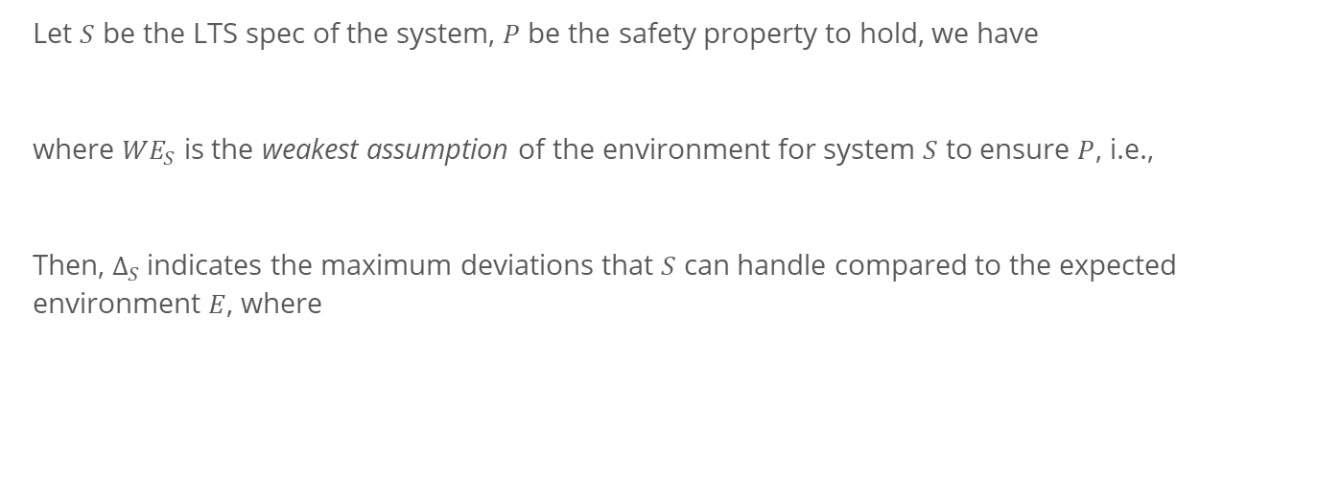
Another way around
Let $S$ be the LTS spec of the system, $P$ be the safety property to hold, we have
where ${WE}_{S}$ is the weakest assumption of the environment for system $S$ to ensure $P$, i.e.,
Then, $Δ_{S}$indicates the maximum deviations that $S$ can handle compared to the expected environment $E$, where

Slide 28
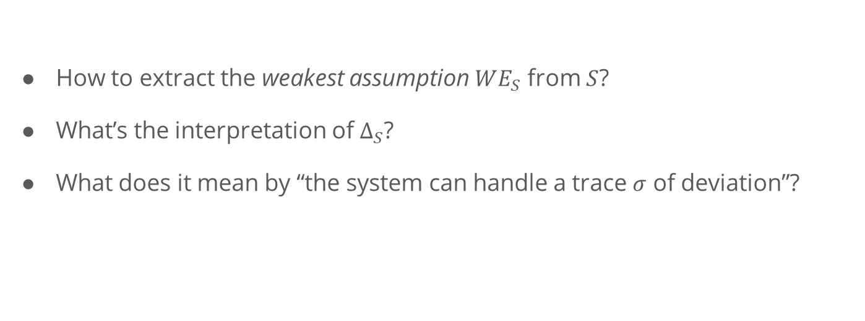
Questions to solve
How to extract the weakest assumption $WE_{S}$ from $S$?
What’s the interpretation of $∆_{S}$?
What does it mean by “the system can handle a trace $σ$ of deviation”?

Slide 29
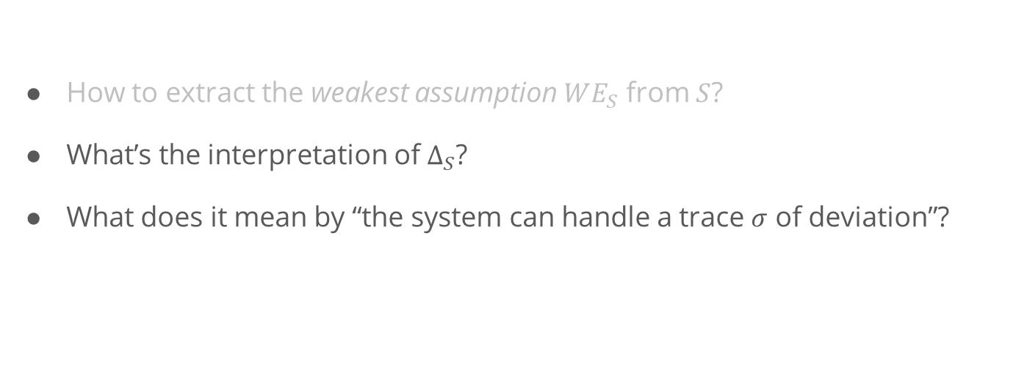
Questions to solve
Starting Point: Existing work present solutions to these problems based on automata theory.
How to extract the weakest assumption $WE_{S}$ from $S$?
What’s the interpretation of $∆_{S}$?
What does it mean by “the system can handle a trace $σ$ of deviation”?
Our Focus

Slide 30
Generating Weakest Assumption

Slide 31
Generating Weakest Assumption
[Dimitra02] presents an approach to generate the weakest assumption.
[Dimitra02] D. Giannakopoulou, C. S. Pǎsǎreanu, and H. Barringer, “Assumption generation for software component verification,” in Proceedings - ASE 2002: 17th IEEE International Conference on Automated Software Engineering, 2002, pp. 3–12.

Slide 32
Interpretation of $Δ$

Slide 33
Representation of Robustness

Slide 34
Representation of Errors/Robustness
Based on LTS, errors can be represented by a set of traces, but they are not self-explainable.
Existing Work:
In distributed systems, different fault models capture varies of failure types (e.g., fail-stop, fail-silent, or fail-arbitrary).
In human behavior study, models are developed to classify erroneous human behaviors (e.g., omissions, repetitions, and commissions).
Notes:
In our context, the representation of errors and the representation of robustness refer to the same thing.

Slide 35
Representation of Errors/Robustness
Based on LTS, errors can be represented by a set of traces, but they are not self-explainable.
Existing Work:
In distributed systems, different fault models capture varies of failure types (e.g., fail-stop, fail-silent, or fail-arbitrary).
In human behavior study, models are developed to classify erroneous human behaviors (e.g., omissions, repetitions, and commissions).
Can we map the traces to these models?
Notes:
In our context, the representation of errors and the representation of robustness refer to the same thing.

Slide 36
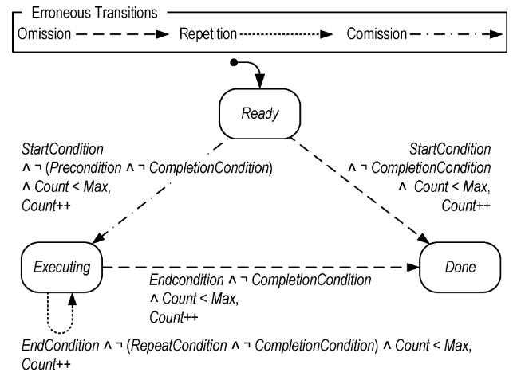
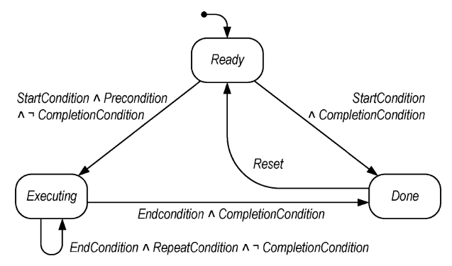
Human Behavior Model: EOFM
[Bolton13] Bolton, M. L., & Bass, E. J. (2013). Generating erroneous human behavior from strategic knowledge in task models and evaluating its impact on system safety with model checking. IEEE Transactions on Systems, Man, and Cybernetics: Systems, 43(6), 1314–1327. https://doi.org/10.1109/TSMC.2013.2256129
Notes:
EOFM is a human task model, it describes that to complete a task, what a human operator should do, when they should perform an action, and when the action is done.
A human activity or action is modeled as a state machine. 3 states: ready refers to the activity is waiting to execute, executing refers to the activity is executing, done refers to the activity is done.
Lines refer to the transitions and labels on the lines refer to the condition to execute a transition.

Slide 37
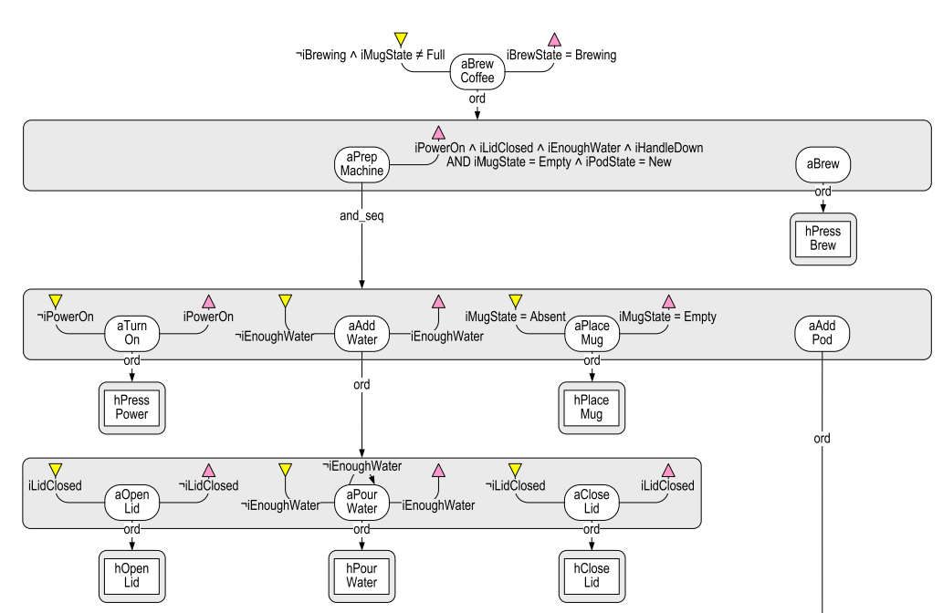
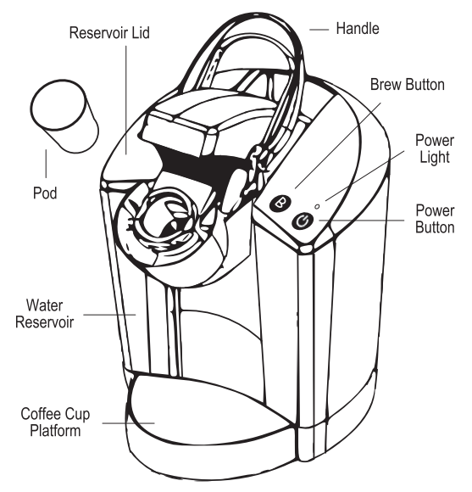
Human Behavior Model: EOFM

Slide 38
Human Behavior Model: EOFM
Intuitively, a user should perform an action if the precondition is satisfied and it is not completed.
[Bolton13] Bolton, M. L., & Bass, E. J. (2013). Generating erroneous human behavior from strategic knowledge in task models and evaluating its impact on system safety with model checking. IEEE Transactions on Systems, Man, and Cybernetics: Systems, 43(6), 1314–1327. https://doi.org/10.1109/TSMC.2013.2256129

Slide 39
Human Behavior Model: EOFM
Intuitively, a user should continue performing an action until its completion condition is reached.
[Bolton13] Bolton, M. L., & Bass, E. J. (2013). Generating erroneous human behavior from strategic knowledge in task models and evaluating its impact on system safety with model checking. IEEE Transactions on Systems, Man, and Cybernetics: Systems, 43(6), 1314–1327. https://doi.org/10.1109/TSMC.2013.2256129

Slide 40
Erroneous Human Behaviors
Omission Error-1: A user should perform an action but not!
[Bolton13] Bolton, M. L., & Bass, E. J. (2013). Generating erroneous human behavior from strategic knowledge in task models and evaluating its impact on system safety with model checking. IEEE Transactions on Systems, Man, and Cybernetics: Systems, 43(6), 1314–1327. https://doi.org/10.1109/TSMC.2013.2256129

Slide 41
Erroneous Human Behaviors
Omission Error-2: A user should continue performing an action but stop executing it prematurely!
[Bolton13] Bolton, M. L., & Bass, E. J. (2013). Generating erroneous human behavior from strategic knowledge in task models and evaluating its impact on system safety with model checking. IEEE Transactions on Systems, Man, and Cybernetics: Systems, 43(6), 1314–1327. https://doi.org/10.1109/TSMC.2013.2256129

Slide 42
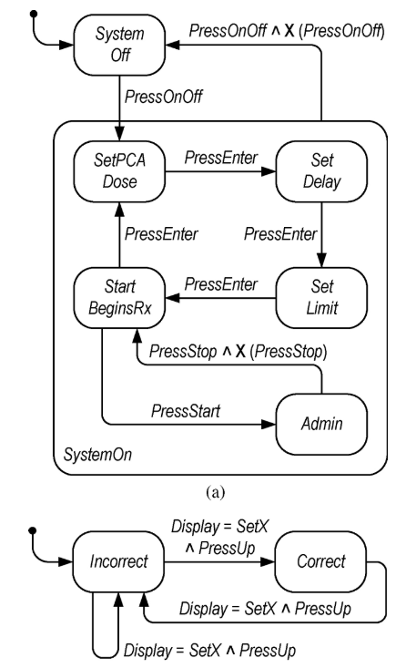
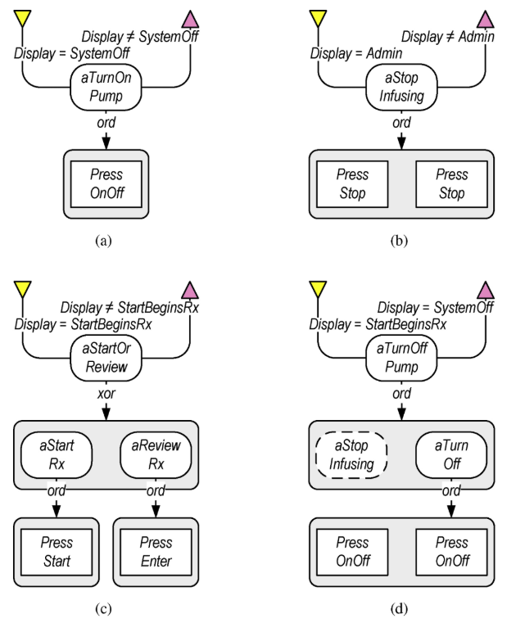
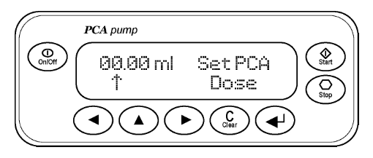
Current Progress
Notes:
Can we extract the design decisions with respect to the robustness of an infusion pump.
Can we map the delta traces we found in the weakest assumption back to the human behavior model.

Slide 43
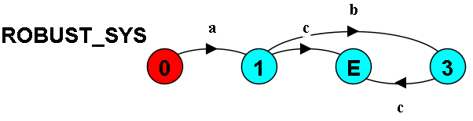
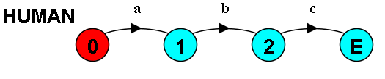
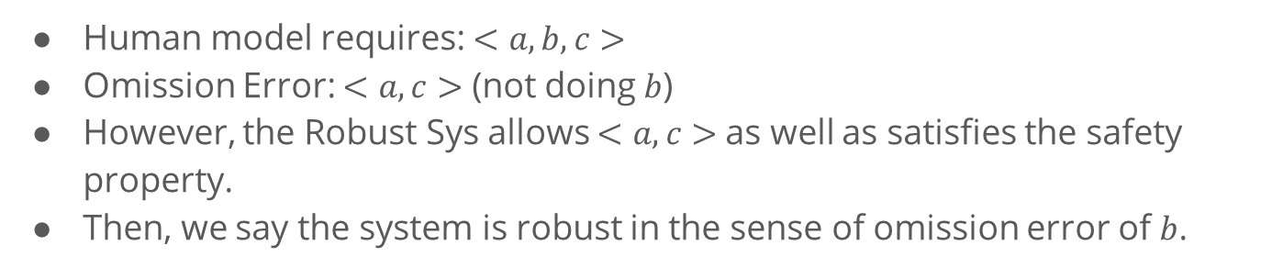
Current Progress
Human model requires: $<a, b, c>$
Omission Error: $<a, c>$ (not doing $b$)
However, the Robust Sys allows $<a, c>$as well as satisfies the safety property.
Then, we say the system is robust in the sense of omission error of $b$.

Slide 44
Discussion

Slide 45
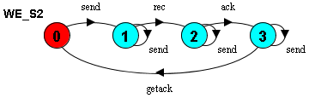
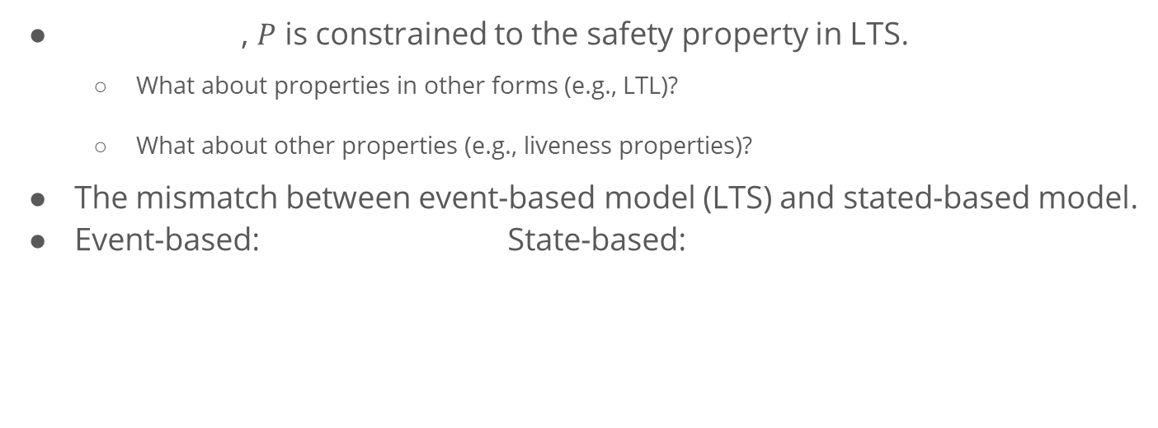
Current Limitations and Challenges
, $P$ is constrained to the safety property in LTS.
What about properties in other forms (e.g., LTL)?
What about other properties (e.g., liveness properties)?
The mismatch between event-based model (LTS) and stated-based model.
Event-based: State-based:
Notes:
In event-based model, we are talking about after doing a, we should do b.
But in state-based model, we are talking about under what conditions we can do a or b.
They can be used to model the same system, but with different focus. Often, state-based model is more expressive, but we are constrained by the previous work on generating weakest assumption.

Slide 46
Thank You!
What is Robustness?
Approach Overview
Generating Weakest Assumption
Representation of Robustness
Discussion

